Slide 1

Philippine Energy
Landscape:
Transitioning Towards
Renewable Energy
A 20-Year Look at Electricity Generation & Installed Capacity (2003–2023)
DATA ANALYTICS PORTFOLIO | SYRUS MAC GUTIERREZ

Slide 2
Philippines’ Background
The Philippines’ electricity demand has grown rapidly across all major island grids in recent decades.
Growing demand and sustainability concerns are shaping the country’s shift toward cleaner energy.
Renewable energy capacity has expanded steadily nationwide, but coal growth still heavily dominates the overall power mix.

Slide 3
Project Scope
01 Uses DOE historical energy generation and installed capacity data (2003–2023).
02 Compares renewable vs. non-renewable energy trends across Luzon, Visayas, and Mindanao.
03 Examines how generation growth relates to installed capacity
04 Focuses on clear storytelling using historical energy data (no cost or policy modeling)

Slide 4
Problem Statement
The Philippines still relies heavily on coal even as electricity demand continues to rise. By analyzing 20 years of DOE data, this project shows how the energy mix has shifted, how renewables are performing, and where improvement is still needed.

Slide 5
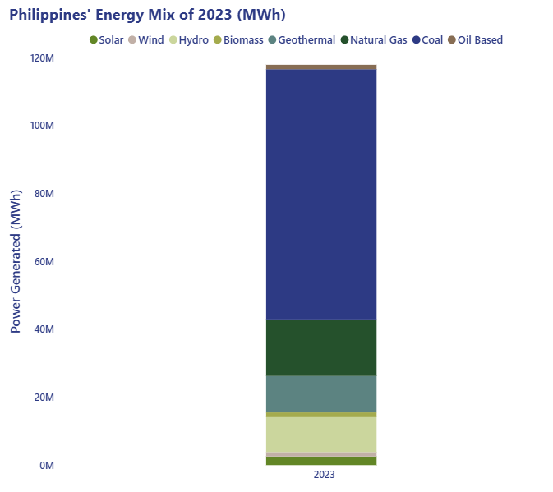
Philippine Energy Mix in 2023
Coal remains the largest source of electricity in 2023, making up more than half of the national grid.
Fossil fuels still supply majority of energy, highlighting need for transition.
Breakdown of electricity generation by source, showing strong reliance on fossil fuels.

Slide 6
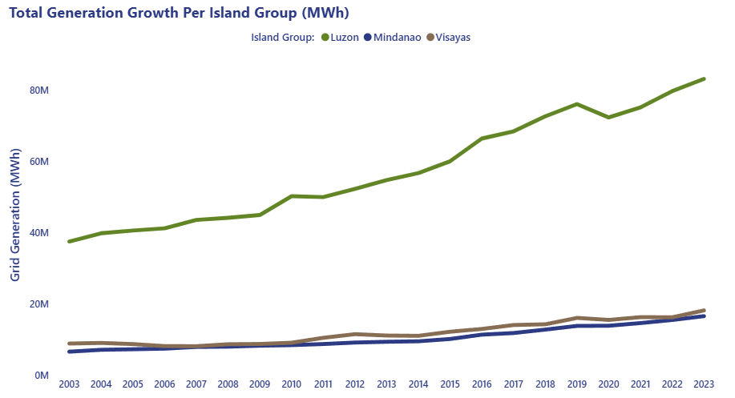
Total Energy Generation Trends
Luzon’s electricity generation accelerated sharply after 2010, driven largely by coal expansion.

Slide 7
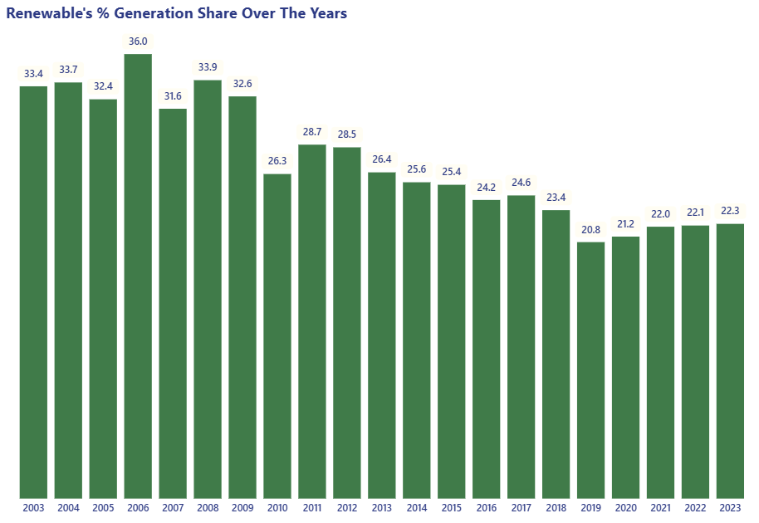
Renewable Energy Share
Renewable share fell from 33.4% to 22.3% (2003–2023).
Renewables grew in output, but their share dropped as coal expanded faster.

Slide 8
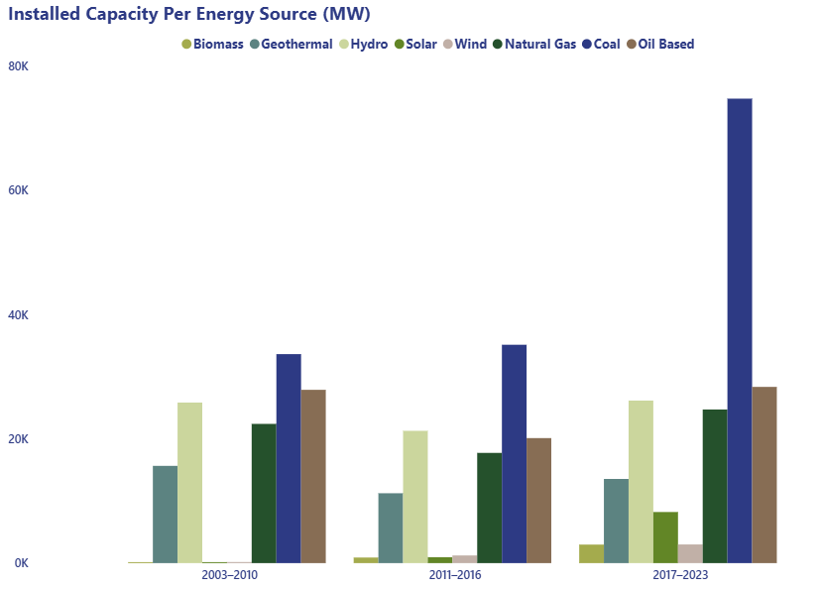
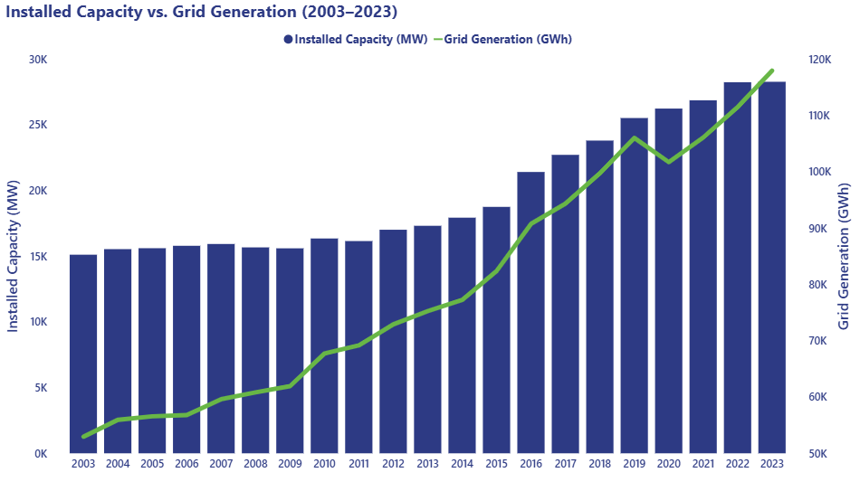
Installed Capacity and Generation Trends
Coal and hydro hold the largest installed capacity, while solar and wind only began scaling in the 2010s.
Generation grows faster than capacity, showing increased grid utilization and rising national demand.

Slide 9
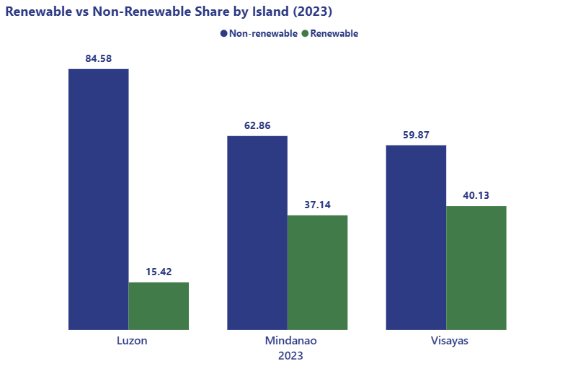
Non-renewables vs Renewables
%
%
%
%
%
%
Visayas and Mindanao have stronger renewable penetration, while Luzon remains heavily dependent on fossil fuels.

Slide 10
Overall Highlights
Total generation hit 118 TWh in 2023, almost double early-2000 levels, showing strong demand growth.
Installed capacity kept rising, driven by coal and gas in Luzon, and more renewables in Visayas and Mindanao.
Coal (53 TWh) and natural gas (16.6 TWh) remain the top power sources across all grids.
Renewables produce 18–20 TWh, with hydro and geothermal as steady baseload, and solar/wind growing fastest.
Renewable share is now around 15–20%, boosted mainly by solar and wind expansion in the last decade.
Regional patterns differ: Luzon leads with ~83 TWh, while Visayas and Mindanao rely more on geothermal and hydro.

Slide 11
Where the Philippines Stands Today
01 Coal still dominates the national grid, especially in Luzon.
02 Renewables increased in output but lost share as coal grew faster.
03 Visayas and Mindanao maintain stronger renewable mixes than Luzon.
04 Rising generation outpaces capacity growth, showing increasing demand pressure.
Overall, the country’s transition to clean energy is moving, but not yet fast enough to shift the national energy mix.

Slide 12
Sources
Installed Capacity Per Grid
Gross Power Generation

